Slide 1

Cyber Samurai サイバーサムライ
Game Store Project

Slide 2
OUR TEAM
Khin Wine
Hein Htet Zin
Frontend Developer
Full Stack Developer

Slide 3
TABLE OF CONTENTS
01
03
02
04
About Cyber Samurai
Documentation
Development
Cyber Samurai Website

Slide 4
01
ABOUT CYBER SAMURAI

Slide 5



What this website can offer...
Cyber Samurai website sell physical disks of different video games
Order any official game disks you like
Support various games
Note: the users will have to purchase game disks within 3 days after ordering.

Slide 6
Platforms
PS5 | PS4 | XBOX SERIES | NINTENDO SWITCH
2020 | 2013 | 2020 | 2017
Sony Interactive Entertainment | Sony Interactive Entertainment | Microsoft | Nintendo
$499 | $70 | $500, $300 | $299.99

Slide 7

02
Development

Slide 8

DEVELOPMENT TIMELINE
Use Case/ Docs
First Week
Second Week
Third Week
Samurai Trio
Frame + Backend
Frontend
Final

Slide 9
Overview
Register
Create, Update, Delete
Game Lists
View
Edit
Game Details
View
View
Game History
View
New User
Purchase
Log in
Cart / Wishlist
Admin
View
User Lists
View
[ can edit status ]
User Details
Log in
Edit
Profile
Edit
Registered User
Log Out

Slide 10
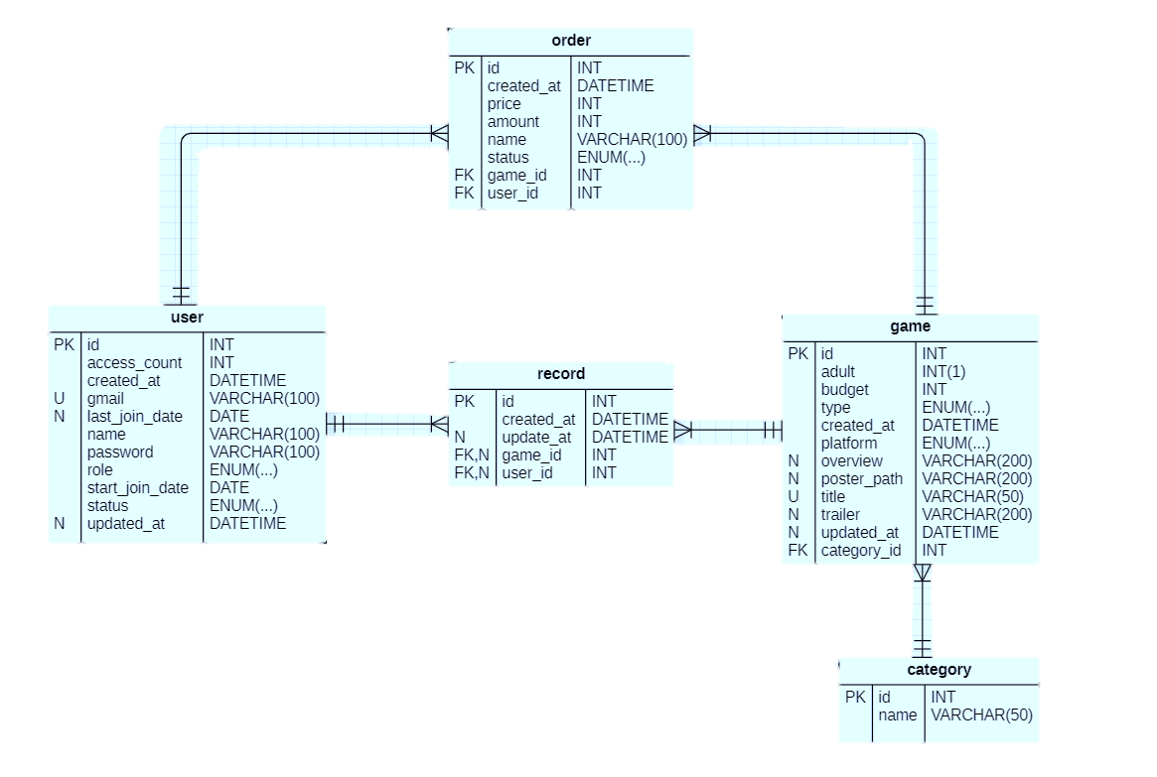
ER Diagram

Slide 11
03
Documentation

Slide 12
Documentation
DB設計
基本設計
詳細設計

Slide 13
04
Cyber Samurai Website

Slide 14

Cyber Samurai Website
It’s time to check out Cyber Samurai Website.

Slide 15

THANKS!
Do you have any questions?
haynesart11@gmail.com
+95 95077945 https://github.com/Hein-Htet-11

